Slide 1
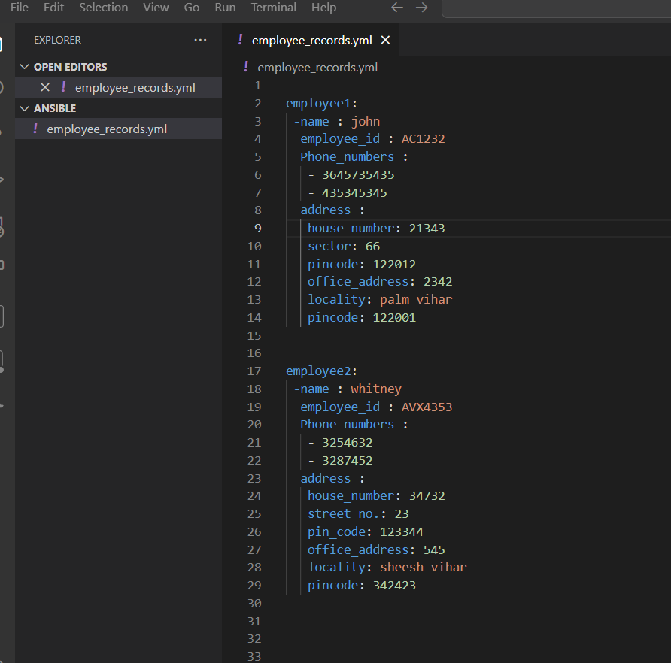

Slide 2
---
employee1:
-name : john
employee_id : AC1232
Phone_numbers :
- 3645735435
- 435345345
address :
house_number: 21343
sector: 66
pincode: 122012
office_address: 2342
locality: palm vihar
pincode: 122001
employee2:
-name : whitney
employee_id : AVX4353
Phone_numbers :
- 3254632
- 3287452
address :
house_number: 34732
street no.: 23
pin_code: 123344
office_address: 545
locality: sheesh vihar
pincode: 342423

